Slide 1
Covid-19 Anomaly Detection Models
Algorithms and Code

Slide 2
Principal Component Analysis

Slide 3
Estimation Method Details
LOF
PCA
An unsupervised anomaly detection method which computes the local density deviation of a given data point with respect to its neighbors. It considers as outliers the samples that have a substantially lower density than their neighbors.
Solves the problem by analyzing available features to determine what constitutes a "normal" class. The component then applies distance metrics to identify cases that represent anomalies. This approach lets you train a model by using existing imbalanced data

Slide 4
Review of PCA for Anomaly Detection
Every time point is a vector in high dimensional space
We track the reconstruction error of these vectors
Analyze available features to determine what constitutes a "normal" class
The component then applies distance metrics to identify cases that represent anomalies
Before running the PCA outlier detection code, we run a basic PCA algorithm to get the number of principal components to use on our data.

Slide 5
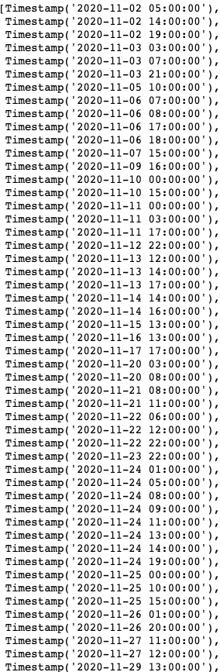
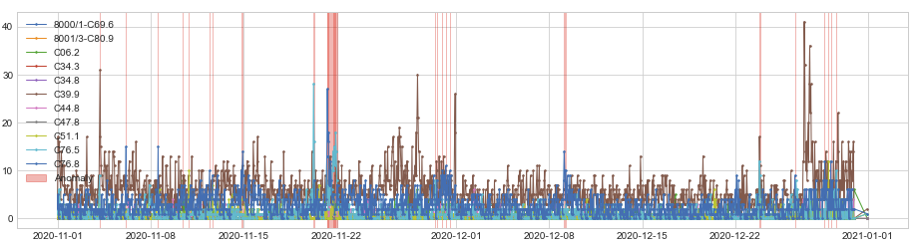
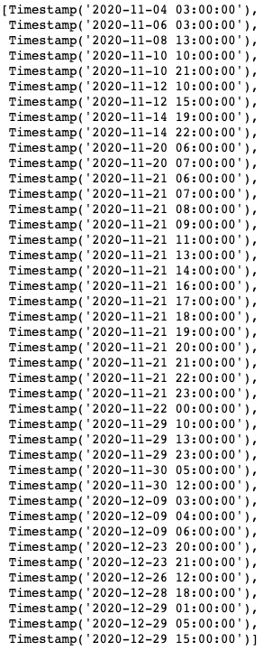
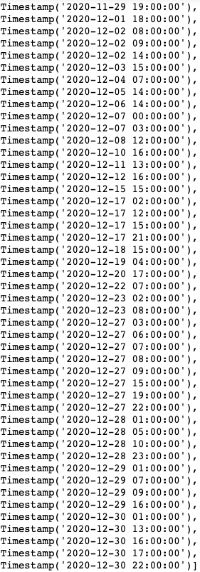
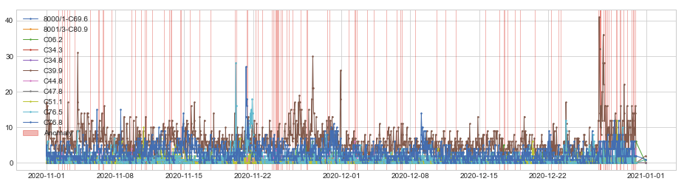
K = 1
K = 5

Slide 6
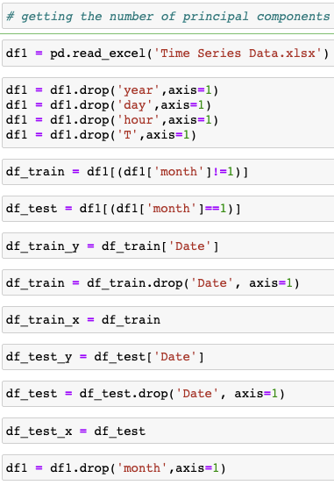
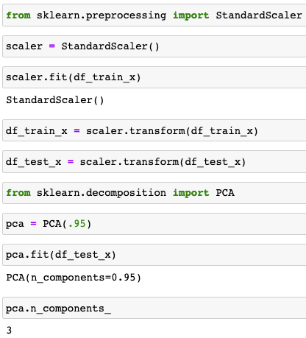
Getting the optimal numbers of principal components
3 principal components will be used for our algorithm

Slide 7
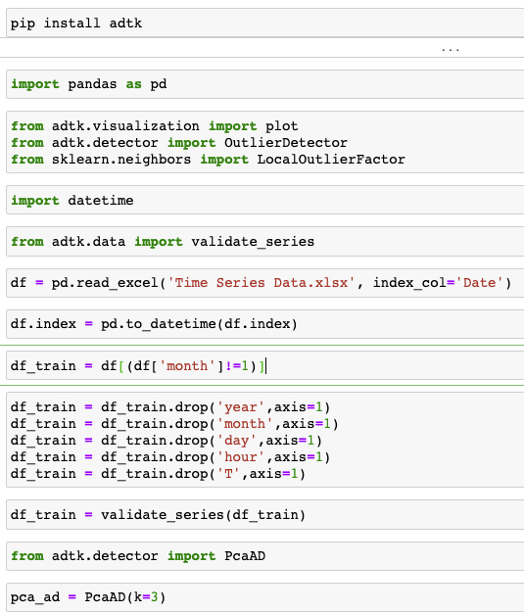
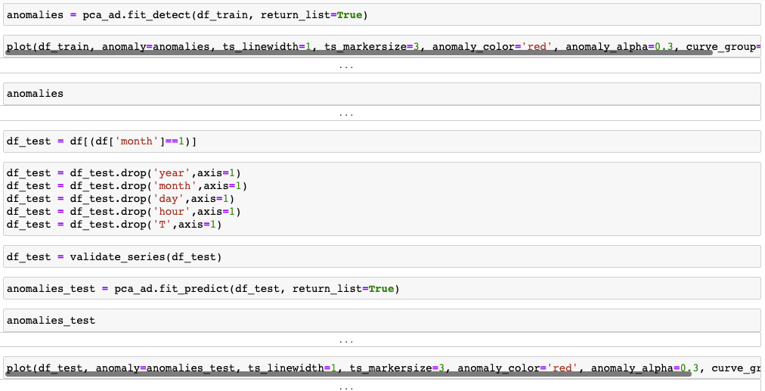
ADTK PCA Process

Slide 8
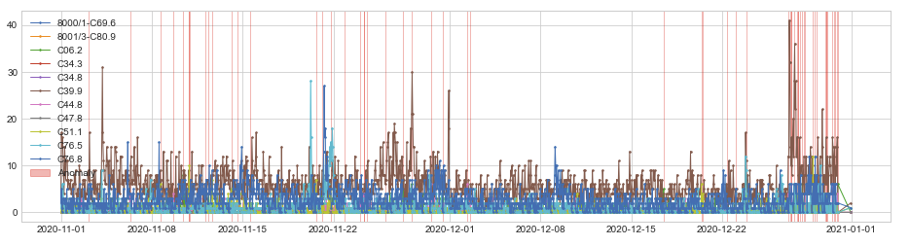
[Timestamp('2020-11-03 03:00:00'),
Timestamp('2020-11-06 08:00:00'),
Timestamp('2020-11-08 15:00:00'),
Timestamp('2020-11-09 16:00:00'),
Timestamp('2020-11-10 10:00:00'),
Timestamp('2020-11-10 20:00:00'),
Timestamp('2020-11-10 21:00:00'),
Timestamp('2020-11-10 22:00:00'),
Timestamp('2020-11-12 03:00:00'),
Timestamp('2020-11-12 09:00:00'),
Timestamp('2020-11-12 15:00:00'),
Timestamp('2020-11-14 03:00:00'),
Timestamp('2020-11-14 14:00:00'),
Timestamp('2020-11-15 13:00:00'),
Timestamp('2020-11-20 16:00:00'),
Timestamp('2020-11-21 03:00:00'),
Timestamp('2020-11-21 19:00:00'),
Timestamp('2020-11-22 20:00:00'),
Timestamp('2020-11-24 01:00:00'),
Timestamp('2020-11-24 08:00:00'),
Timestamp('2020-11-24 09:00:00'),
Timestamp('2020-11-24 14:00:00'),
Timestamp('2020-11-26 01:00:00'),
Timestamp('2020-11-27 09:00:00'),
Timestamp('2020-11-28 01:00:00'),
Timestamp('2020-11-29 13:00:00'),
Timestamp('2020-11-30 11:00:00'),
Timestamp('2020-12-02 08:00:00'),
Timestamp('2020-12-02 14:00:00'),
Timestamp('2020-12-17 12:00:00'),
Timestamp('2020-12-20 10:00:00'),
Timestamp('2020-12-20 13:00:00'),
Timestamp('2020-12-22 10:00:00'),
Timestamp('2020-12-23 02:00:00'),
Timestamp('2020-12-23 22:00:00'),
Timestamp('2020-12-27 03:00:00'),
Timestamp('2020-12-27 07:00:00'),
Timestamp('2020-12-27 08:00:00'),
Timestamp('2020-12-27 09:00:00'),
Timestamp('2020-12-27 14:00:00'),
Timestamp('2020-12-27 19:00:00'),
Timestamp('2020-12-27 21:00:00'),
Timestamp('2020-12-27 22:00:00'),
Timestamp('2020-12-28 01:00:00'),
Timestamp('2020-12-28 05:00:00'),
Timestamp('2020-12-28 09:00:00'),
Timestamp('2020-12-28 10:00:00'),
Timestamp('2020-12-29 01:00:00'),
Timestamp('2020-12-29 04:00:00'),
Timestamp('2020-12-29 07:00:00'),
Timestamp('2020-12-30 00:00:00'),
Timestamp('2020-12-30 01:00:00'),
Timestamp('2020-12-30 02:00:00'),
Timestamp('2020-12-30 04:00:00'),
Timestamp('2020-12-30 13:00:00'),
Timestamp('2020-12-30 16:00:00'),
Timestamp('2020-12-30 18:00:00'),
Timestamp('2020-12-30 22:00:00'),
Timestamp('2020-12-30 23:00:00')]
Training Data K = 3

Slide 9
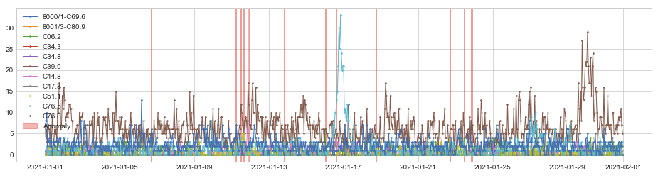
[(Timestamp('2021-01-06 16:00:00', freq='H'),
Timestamp('2021-01-06 16:59:59.999999999', freq='H')),
(Timestamp('2021-01-11 05:00:00', freq='H'),
Timestamp('2021-01-11 05:59:59.999999999', freq='H')),
(Timestamp('2021-01-11 11:00:00', freq='H'),
Timestamp('2021-01-11 11:59:59.999999999', freq='H')),
(Timestamp('2021-01-11 14:00:00', freq='H'),
Timestamp('2021-01-11 14:59:59.999999999', freq='H')),
(Timestamp('2021-01-11 16:00:00', freq='H'),
Timestamp('2021-01-11 16:59:59.999999999', freq='H')),
(Timestamp('2021-01-11 20:00:00', freq='H'),
Timestamp('2021-01-11 21:59:59.999999999', freq='H')),
(Timestamp('2021-01-13 19:00:00', freq='H'),
Timestamp('2021-01-13 19:59:59.999999999', freq='H')),
(Timestamp('2021-01-16 00:00:00', freq='H'),
Timestamp('2021-01-16 00:59:59.999999999', freq='H')),
(Timestamp('2021-01-16 14:00:00', freq='H'),
Timestamp('2021-01-16 14:59:59.999999999', freq='H')),
(Timestamp('2021-01-18 17:00:00', freq='H'),
Timestamp('2021-01-18 17:59:59.999999999', freq='H')),
(Timestamp('2021-01-22 16:00:00', freq='H'),
Timestamp('2021-01-22 16:59:59.999999999', freq='H')),
(Timestamp('2021-01-23 11:00:00', freq='H'),
Timestamp('2021-01-23 11:59:59.999999999', freq='H')),
(Timestamp('2021-01-23 20:00:00', freq='H'),
Timestamp('2021-01-23 21:59:59.999999999', freq='H'))]
Testing Data K = 3

Slide 10
Potential “gaps” of PCA Anomaly Detection
Data standardization is necessary to run the algorithm
Principal components are not readable / interpretable compared to original features
There is always the fear of information loss during the PCA process
We do our best by running the dimensionality reduction code and picking the optimal number of principal components, but it is never perfect

Slide 11
Local Outlier Factor

Slide 12
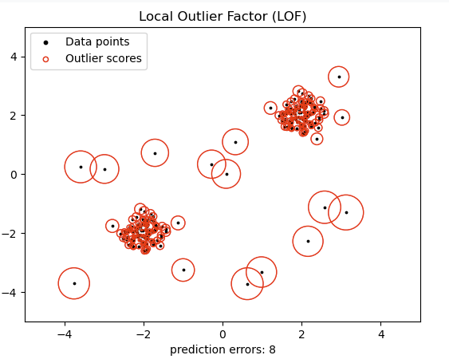
Anomaly Detection Methodology Review
Compute the local density deviation of a given data point with respect to its neighbors
It considers as outliers the samples that have a substantially lower density than their neighbors

Slide 13
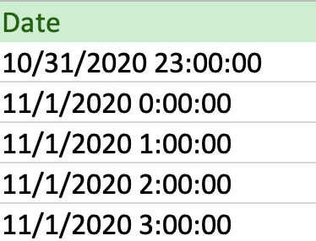
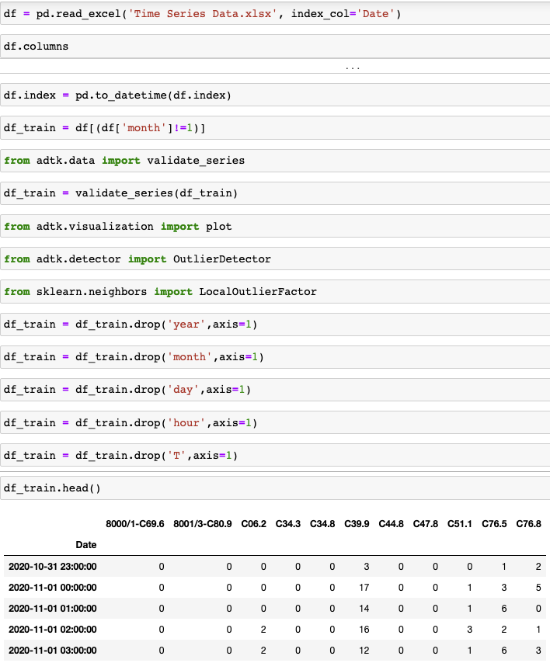
Create a column that has day-month-year-hour
Read in the data and set this new date column to the index, change the index to pd.datetime, create a training set, import necessary libraries, validate the training set, drop the un-important columns

Slide 14

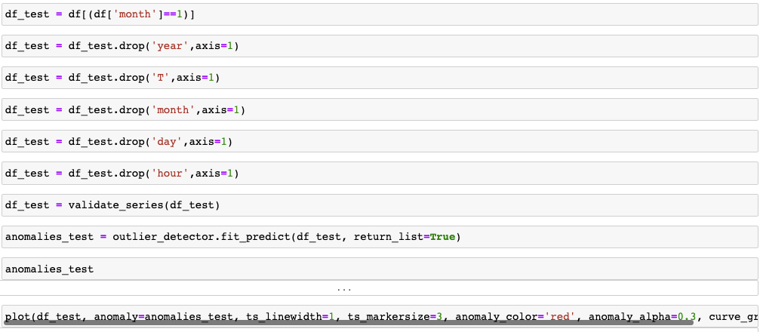
Create an outlier detection method using scikit-learn’s Local Outlier Factor module and fit that model to the training data in order to detect anomalies in the training set
Create the test set and clean it up, use the predict() function to take the previous local outlier factor model and predict testing values on the new data

Slide 15
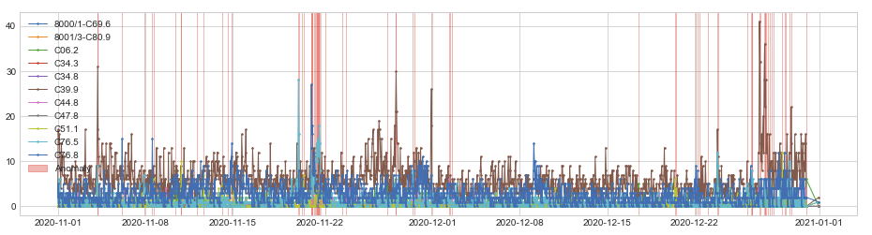
[Timestamp('2020-11-04 03:00:00'),
Timestamp('2020-11-04 04:00:00'),
Timestamp('2020-11-06 03:00:00'),
Timestamp('2020-11-07 21:00:00'),
Timestamp('2020-11-08 13:00:00'),
Timestamp('2020-11-08 15:00:00'),
Timestamp('2020-11-10 10:00:00'),
Timestamp('2020-11-10 20:00:00'),
Timestamp('2020-11-10 21:00:00'),
Timestamp('2020-11-12 03:00:00'),
Timestamp('2020-11-12 15:00:00'),
Timestamp('2020-11-14 03:00:00'),
Timestamp('2020-11-14 14:00:00'),
Timestamp('2020-11-14 22:00:00'),
Timestamp('2020-11-20 06:00:00'),
Timestamp('2020-11-20 07:00:00'),
Timestamp('2020-11-20 13:00:00'),
Timestamp('2020-11-20 16:00:00'),
Timestamp('2020-11-21 06:00:00'),
Timestamp('2020-11-21 07:00:00'),
Timestamp('2020-11-21 08:00:00'),
Timestamp('2020-11-21 09:00:00'),
Timestamp('2020-11-21 13:00:00'),
Timestamp('2020-11-21 14:00:00'),
Timestamp('2020-11-21 16:00:00'),
Timestamp('2020-11-21 17:00:00'),
Timestamp('2020-11-21 18:00:00'),
Timestamp('2020-11-21 19:00:00'),
Timestamp('2020-11-21 20:00:00'),
Timestamp('2020-11-21 21:00:00'),
Timestamp('2020-11-21 22:00:00'),
Timestamp('2020-11-21 23:00:00'),
Timestamp('2020-11-22 10:00:00'),
Timestamp('2020-11-23 18:00:00'),
Timestamp('2020-11-24 01:00:00'),
Timestamp('2020-11-27 09:00:00'),
Timestamp('2020-11-28 01:00:00'),
Timestamp('2020-11-28 02:00:00'),
Timestamp('2020-11-29 10:00:00'),
Timestamp('2020-11-29 13:00:00'),
Timestamp('2020-11-30 22:00:00'),
Timestamp('2020-12-02 08:00:00'),
Timestamp('2020-12-02 09:00:00'),
Timestamp('2020-12-02 14:00:00'),
Timestamp('2020-12-17 12:00:00'),
Timestamp('2020-12-20 10:00:00'),
Timestamp('2020-12-20 13:00:00'),
Timestamp('2020-12-22 03:00:00'),
Timestamp('2020-12-22 06:00:00'),
Timestamp('2020-12-22 10:00:00'),
Timestamp('2020-12-23 02:00:00'),
Timestamp('2020-12-23 20:00:00'),
Timestamp('2020-12-23 21:00:00'),
Timestamp('2020-12-26 05:00:00'),
Timestamp('2020-12-26 12:00:00'),
Timestamp('2020-12-26 14:00:00'),
Timestamp('2020-12-26 15:00:00'),
Timestamp('2020-12-27 05:00:00'),
Timestamp('2020-12-27 06:00:00'),
Timestamp('2020-12-27 14:00:00'),
Timestamp('2020-12-27 15:00:00'),
Timestamp('2020-12-27 16:00:00'),
Timestamp('2020-12-27 17:00:00'),
Timestamp('2020-12-27 22:00:00'),
Timestamp('2020-12-28 01:00:00'),
Timestamp('2020-12-28 05:00:00'),
Timestamp('2020-12-28 09:00:00'),
Timestamp('2020-12-29 01:00:00'),
Timestamp('2020-12-29 05:00:00'),
Timestamp('2020-12-29 07:00:00'),
Timestamp('2020-12-29 15:00:00'),
Timestamp('2020-12-29 18:00:00'),
Timestamp('2020-12-30 23:00:00')]
Timestamps of the anomalies detected in training (November and December)

Slide 16
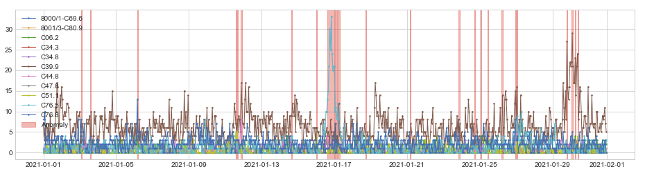
[(Timestamp('2021-01-03 02:00:00', freq='H'),
Timestamp('2021-01-03 02:59:59.999999999', freq='H')),
(Timestamp('2021-01-03 14:00:00', freq='H'),
Timestamp('2021-01-03 14:59:59.999999999', freq='H')),
(Timestamp('2021-01-06 04:00:00', freq='H'),
Timestamp('2021-01-06 04:59:59.999999999', freq='H')),
(Timestamp('2021-01-11 14:00:00', freq='H'),
Timestamp('2021-01-11 14:59:59.999999999', freq='H')),
(Timestamp('2021-01-11 16:00:00', freq='H'),
Timestamp('2021-01-11 16:59:59.999999999', freq='H')),
(Timestamp('2021-01-11 20:00:00', freq='H'),
Timestamp('2021-01-11 21:59:59.999999999', freq='H')),
(Timestamp('2021-01-14 15:00:00', freq='H'),
Timestamp('2021-01-14 15:59:59.999999999', freq='H')),
(Timestamp('2021-01-16 00:00:00', freq='H'),
Timestamp('2021-01-16 00:59:59.999999999', freq='H')),
(Timestamp('2021-01-16 15:00:00', freq='H'),
Timestamp('2021-01-17 00:59:59.999999999', freq='H')),
(Timestamp('2021-01-17 02:00:00', freq='H'),
Timestamp('2021-01-17 03:59:59.999999999', freq='H')),
(Timestamp('2021-01-17 05:00:00', freq='H'),
Timestamp('2021-01-17 06:59:59.999999999', freq='H')),
(Timestamp('2021-01-18 17:00:00', freq='H'),
Timestamp('2021-01-18 17:59:59.999999999', freq='H')),
(Timestamp('2021-01-21 04:00:00', freq='H'),
Timestamp('2021-01-21 04:59:59.999999999', freq='H')),
(Timestamp('2021-01-23 20:00:00', freq='H'),
Timestamp('2021-01-23 21:59:59.999999999', freq='H')),
(Timestamp('2021-01-24 17:00:00', freq='H'),
Timestamp('2021-01-24 17:59:59.999999999', freq='H')),
(Timestamp('2021-01-25 01:00:00', freq='H'),
Timestamp('2021-01-25 01:59:59.999999999', freq='H')),
(Timestamp('2021-01-25 10:00:00', freq='H'),
Timestamp('2021-01-25 10:59:59.999999999', freq='H')),
(Timestamp('2021-01-26 05:00:00', freq='H'),
Timestamp('2021-01-26 05:59:59.999999999', freq='H')),
(Timestamp('2021-01-26 23:00:00', freq='H'),
Timestamp('2021-01-26 23:59:59.999999999', freq='H')),
(Timestamp('2021-01-27 01:00:00', freq='H'),
Timestamp('2021-01-27 01:59:59.999999999', freq='H')),
(Timestamp('2021-01-29 19:00:00', freq='H'),
Timestamp('2021-01-29 19:59:59.999999999', freq='H')),
(Timestamp('2021-01-30 01:00:00', freq='H'),
Timestamp('2021-01-30 02:59:59.999999999', freq='H')),
(Timestamp('2021-01-30 06:00:00', freq='H'),
Timestamp('2021-01-30 06:59:59.999999999', freq='H')),
(Timestamp('2021-01-30 09:00:00', freq='H'),
Timestamp('2021-01-30 09:59:59.999999999', freq='H'))]
Predicted anomalies for January

Slide 17
Potential “gaps” of LOF
When you have a small k-value (only looking at nearby points), the model is more erroneous when the data has a lot of noise
When you have a large k-value, you can often miss local outliers
Conclusion- the software does its best to pick the “perfect k-value” but there will be disadvantages either way

Slide 18
LSTM

Slide 19
LSTM
LSTM models can process multivariate time-series data without the need for dimensionality reduction
Dynamic Error Thresholds
Since environmental factors are currently changing, we need a fast, general, and unsupervised approach.
Gaussian assumptions of past smoothed error allowed us to compare between new and prior errors
However, this approach can be problematic if a parametric assumption was violated

Slide 20
AutoEncoder
An unsupervised Artificial Neural Network
Attempts to encode the data by compressing it into the lower dimensions
Decodes the data to reconstruct the original input
The bottleneck layer (or code) holds the compressed representation of the input data
The number of hidden units in the code is called code size

Slide 21
LSTM Autoencoder
This algorithm follows a similar structure to PCA because reconstruction errors are used to compute anomalies, but this model seems to be more accurate because the model learns the data representation through a more extensive training process. LSTM models utilize a cell state to learn the long term relationships of the data, if data is worth remembering it will pass through a sigmoid function and return a number closer to 1. But if it is worth forgetting, the sigmoid function will return a number closer to zero. The LSTM autoencoder takes LSTMs to another by using their layers as encoders/decoders. Typical autoencoders use encoder functions to decompress the data into a lower dimension and then use decoding functions to learn/recompute the decompressed data into the data’s original dimension. So in an LSTM autoencoder, the first layer uses n neurons, the second layer uses n/2 neurons to decompress the input data, the third layer than repeats the vector to pass it on to the fourth layer and then the last layer recompresses the data into the original data dimension. In our results we observed PCA and the LSTM Autoencoder were the strongest models as it was able to learn the representation of the multivariate data as a whole. But the LSTM autoencoder uses more complex activation functions such as RELU compared to PCA which uses a linear function, which at the end had a greater impact to detect more anomaly time points.
As the LSTM autoencoder was our best performing model, the advantages from the other baseline algorithms were incorporated into the LSTM autoencoder to create an enhanced version which we will be showcased over the coming sections.

Slide 22
VAR

Slide 23
Vector Autoregression (Prediction)
Each variable (time series) is modeled as a function of the past values
The predictors are nothing but the lags (time delated value) of the series
Bi-directional
The variables influence one another
Each variable is modeled as a linear combination of past values of itself and the past values of other variables in the system
Advantages- quickly tests every possible combination of time series and their effects
Disadvantages- does not work well if variables do not affect one another

Slide 24
How do we detect anomalies with VAR?
Use the AUgmented-Dickey Fuller test to test whether each column of the data is stationary or not
If the p-value is less than the significance level than the data is stationary
If not, convert the non-stationary data into stationary data using the “differencing” technique
Fit a time series model to model the relationships between the data using the Vector Auto-Regression model
Find the best lag for the data
Whatever gives the minimum AIC value for the model
In our case, it was lag = 3
The VAR model uses the lags of every column of the data as features and the columns in the provided data as targets
The VAR model is going to fit the generated features and fit the least-squares or linear regression by using every column of the data as targets separately
the reason behind using this kind of method is the presence of autocorrelation in the data
Now by using the selected lag, fit the VAR model and find the squared errors of the data
The squared errors are then used to find the threshold, above which the observations are considered to be anomalies
This is the method to find the threshold- threshold = mean(squared_errors) + z * standard_deviation(squared_errors)

Slide 25
VAR in Python
Analyze the time series characteristics
Test for causation amongst the time series
Test for stationarity
Transform the series to make it stationary, if needed
Find optimal order (p)
Prepare training and test datasets
Train the model
Roll back the transformations, if any.
Evaluate the model using test set
Forecast to future

Slide 26
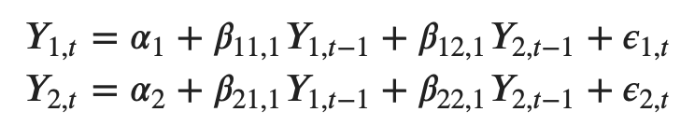
System of equations for VAR with two time series
Notes:
LAGS

Slide 27
How to detect anomalies with VAR
Conduct an ADF test to check whether the data is stationary or not. If the data is not stationary convert the data into stationary data.
After converting the data into stationary data, fit a time-series model to model the relationship between the data.
Find the squared residual errors for each observation and find a threshold for those squared errors.
Any observation’s squared error exceeding the threshold can be marked as an anomaly.

Slide 28
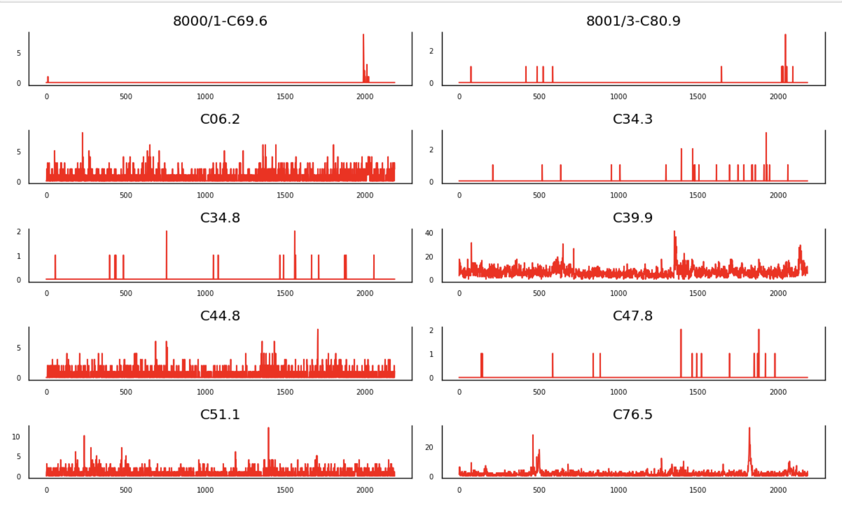
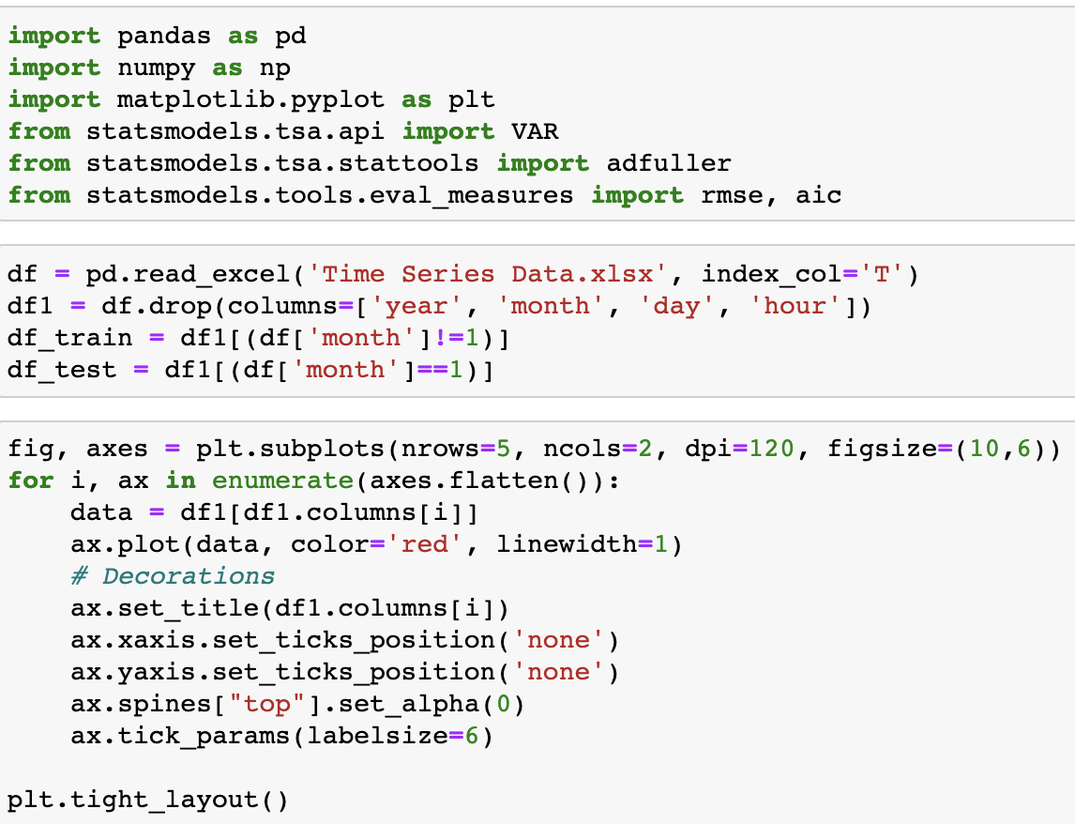

Slide 29
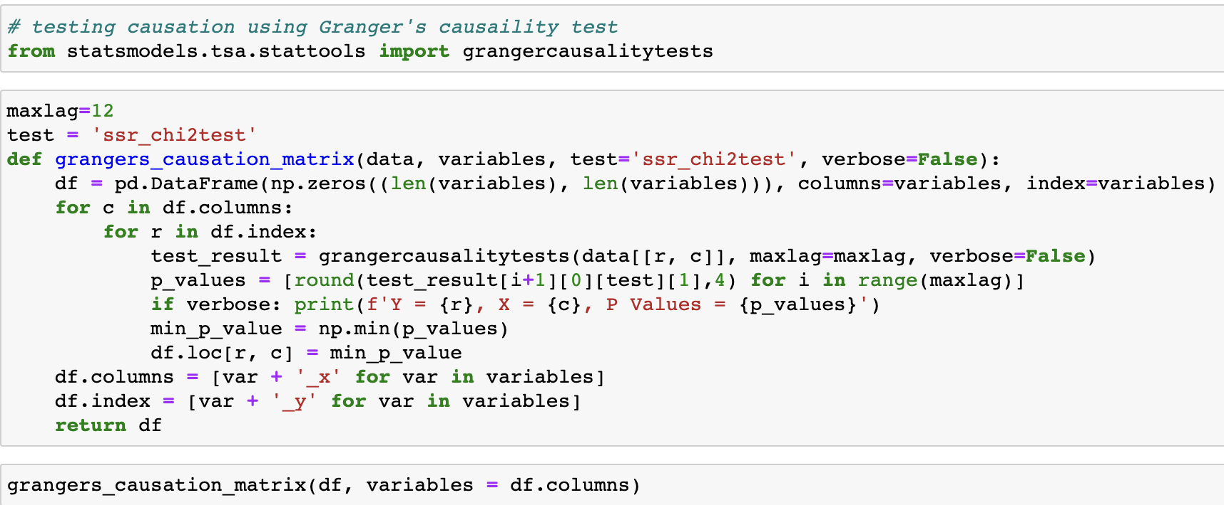

Slide 30
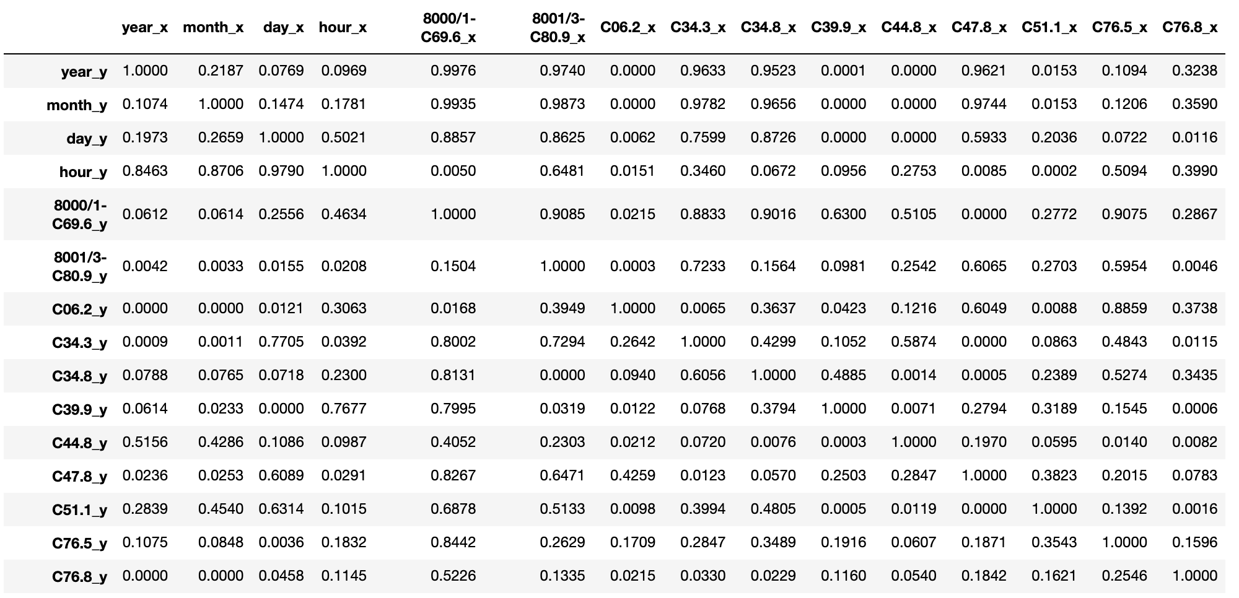
Causality Test Results

Slide 31
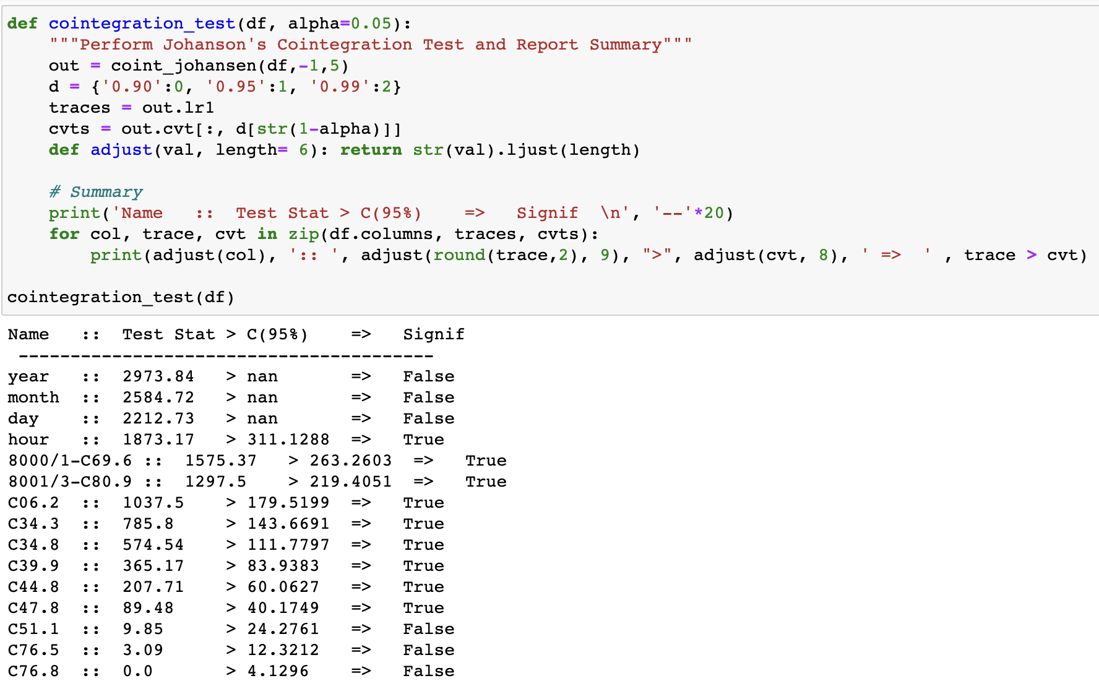
when you have two or more time series, and there exists a linear combination of them that has an order of integration (d) less than that of the individual series, then the collection of series is said to be cointegrated

Slide 32
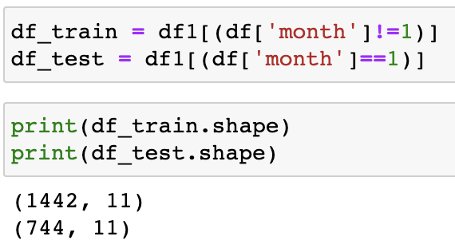
Split the data into training and testing data

Slide 33
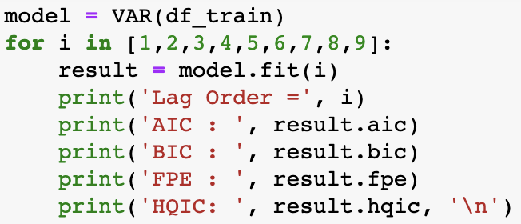
Select the Order (P) of VAR Model
iteratively fit increasing orders of VAR model and pick the order that gives a model with least AIC

Slide 34
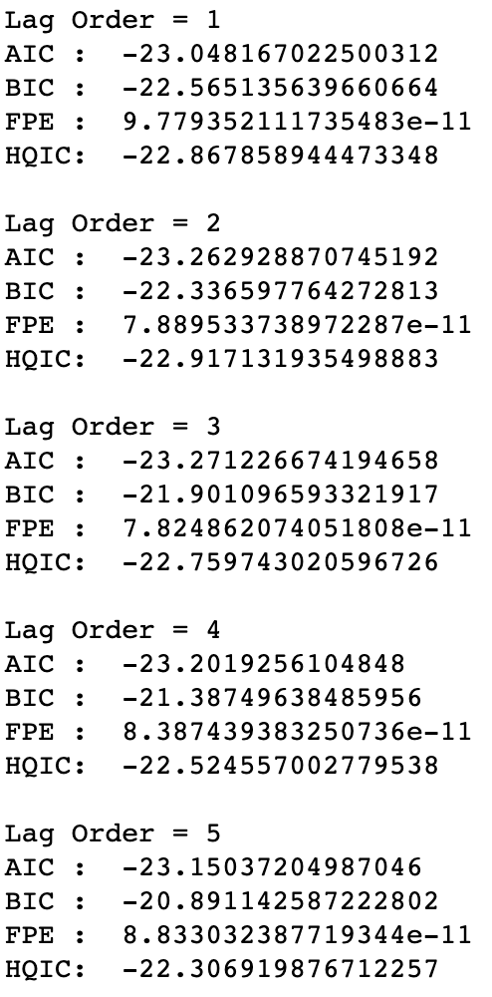
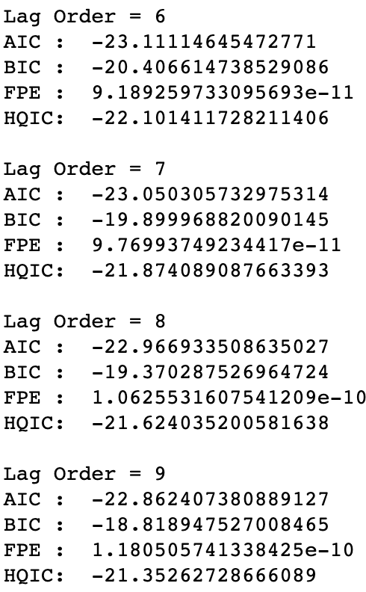
AIC drops to lowest at lag 3, then increases then drops again, so we are going to go with 3

Slide 35
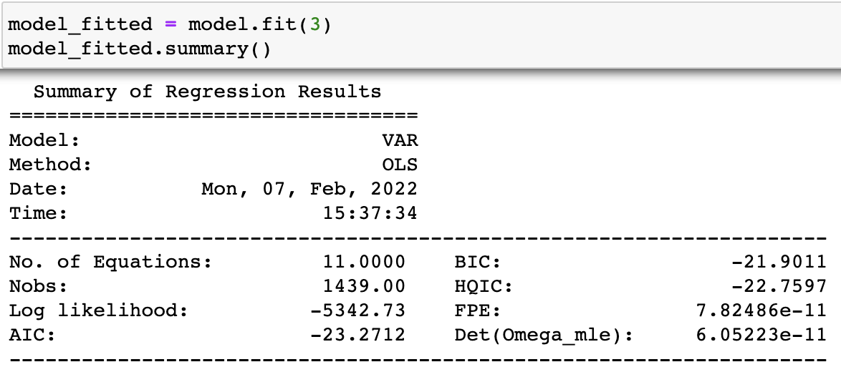
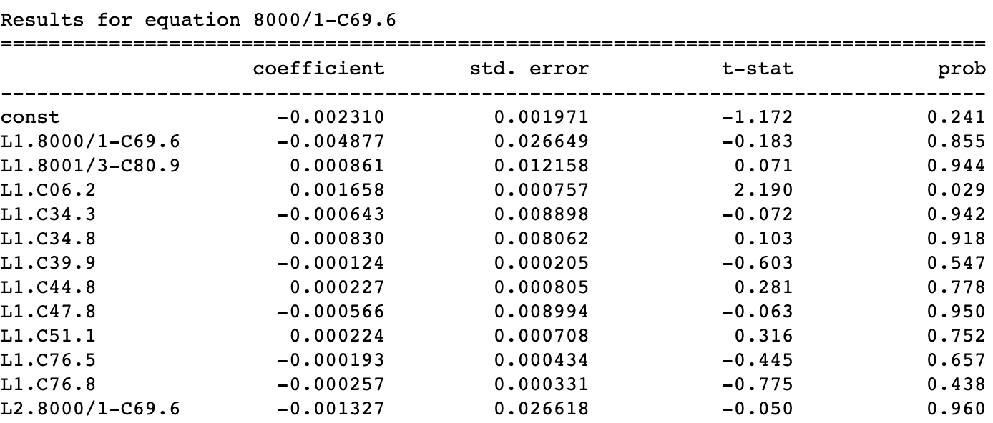
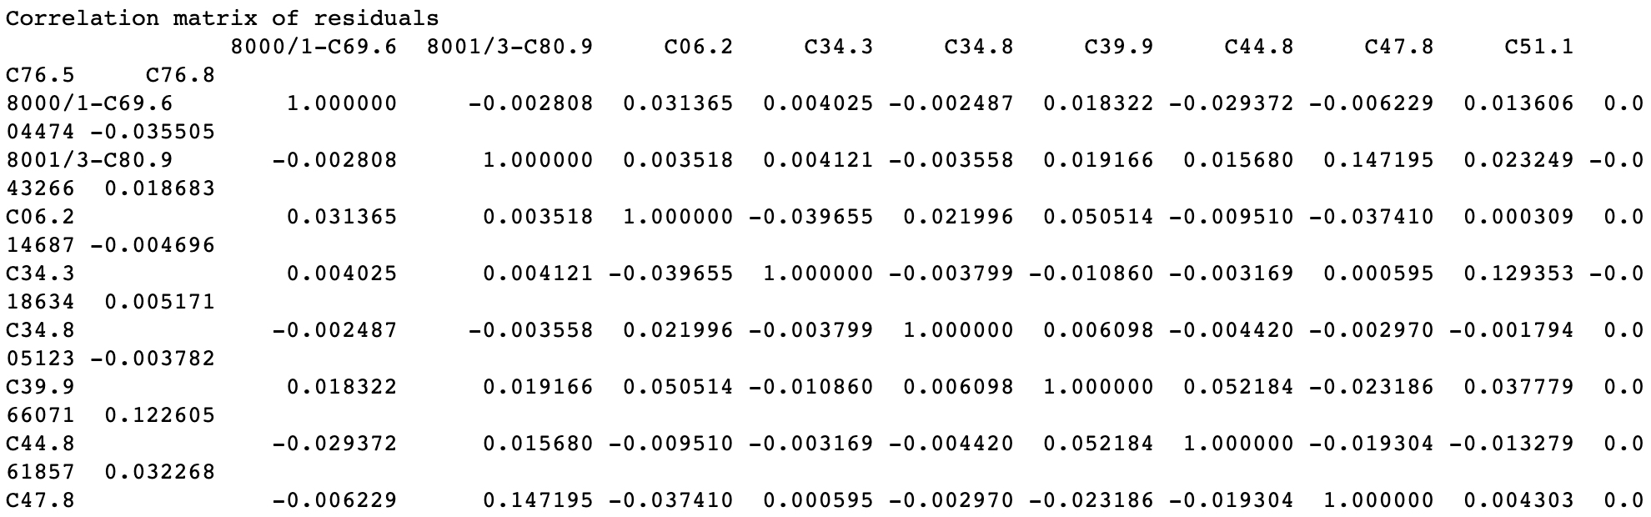
Train the VAR Model

Slide 36
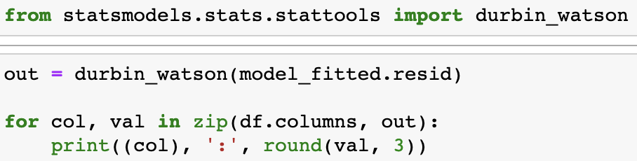
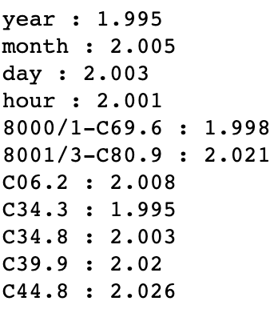
Check for Serial Correlation of Residuals (Errors) using Durbin Watson Statistic
Serial correlation of residuals is used to check if there is any leftover pattern in the residuals (errors).
If there is any correlation left in the residuals, then, there is some pattern in the time series that is still left to be explained by the model.
In that case, the typical course of action is to either increase the order of the model or induce more predictors into the system or look for a different algorithm to model the time series
The closer the values are to 2, there is no significant serial correlation. So we can move on!

Slide 37
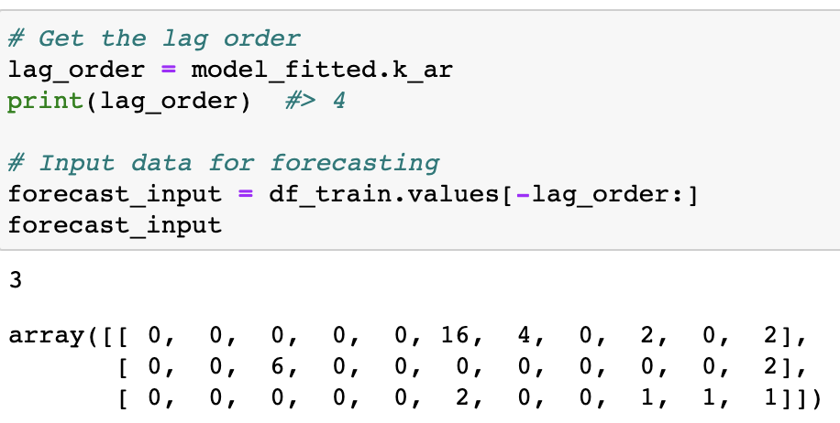
How to Forecast VAR model using statsmodels
In order to forecast, the VAR model expects up to the lag order number of observations from the past data. This is because, the terms in the VAR model are essentially the lags of the various time series in the dataset, so you need to provide it as many of the previous values as indicated by the lag order used by the model.

